Slide 1
Priority Scheduling
Priority Scheduling
Operating Systems and Systems Programming Project
Section: 6
Team No.: 20
Team Members:
Somisetty Ketana Sindhu-2520030487
Yerrolaa Eekshitha— 2520030615
Poojitha Rani— 2520030460

Slide 2
Abstract
A C-based, Linux/Ubuntu terminal-oriented CPU Scheduling project.
Implements Non-Preemptive Priority Scheduling.
Implements Preemptive Priority Scheduling.
Takes Process ID, Arrival Time, Burst Time and Priority as input.
Calculates Completion Time, Turnaround Time, Waiting Time and Response Time.
Generates Gantt Charts to represent process execution.
Demonstrates Linux system calls, process management and IPC concepts.

Slide 3
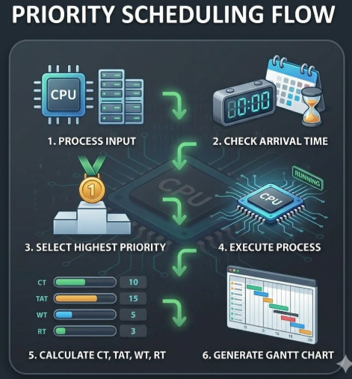
Introduction
Linux-based CPU Scheduling project developed using C.
Implements Priority Scheduling for multiple processes.
Provides:
  Process Input
  Non-Preemptive Scheduling
  Preemptive Scheduling
  Performance Calculation
  Gantt Chart
Uses Arrival Time, Burst Time and Priority.
Smaller priority number represents higher priority.

Slide 4
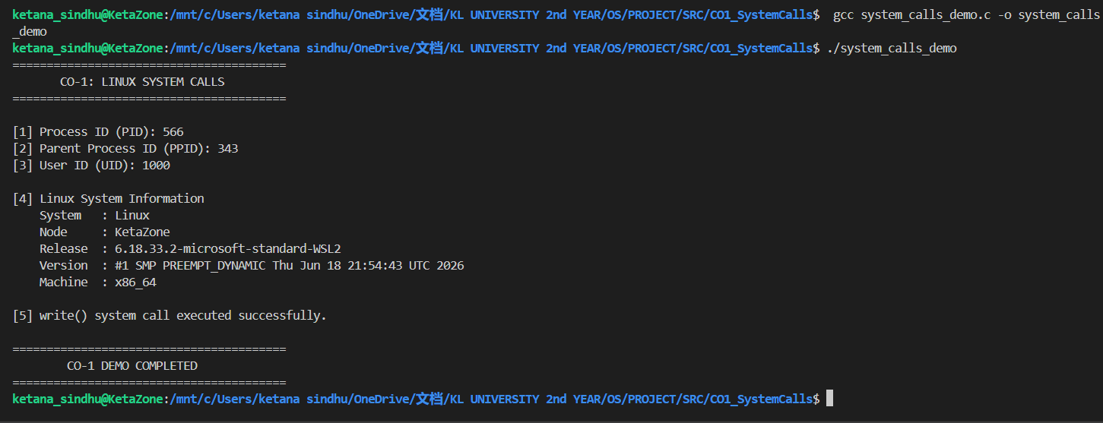
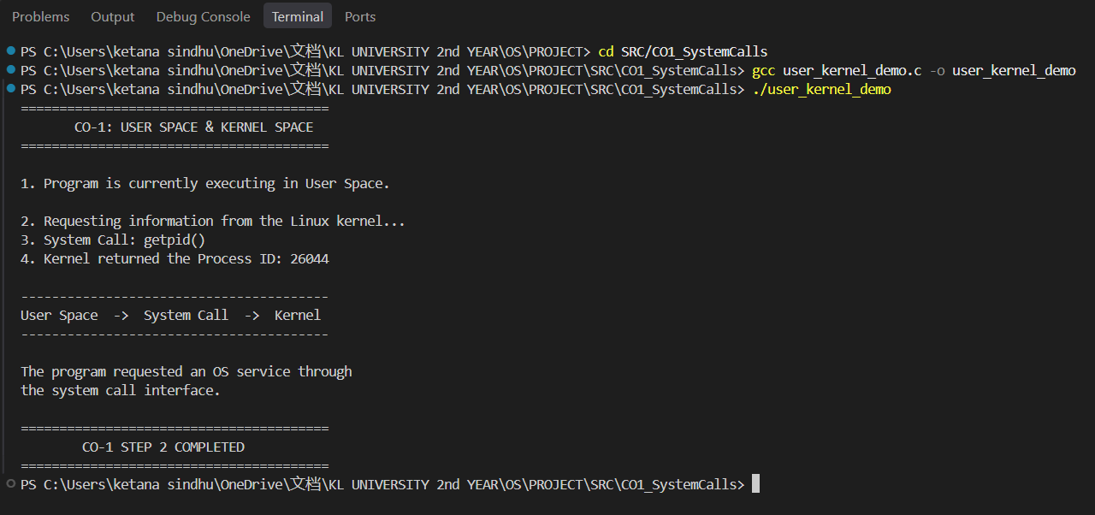
Results – CO1
LINUX SYSTEM CALLS
Implemented basic Linux system calls.
Demonstrated:
  getpid()
  getppid()
  getuid()
  uname()
  write()
Demonstrated user-space and kernel interaction.
Implemented file and system services using:
  open()
  write()
  close()
  getcwd()
Demonstrated shell command execution using system().

Slide 5
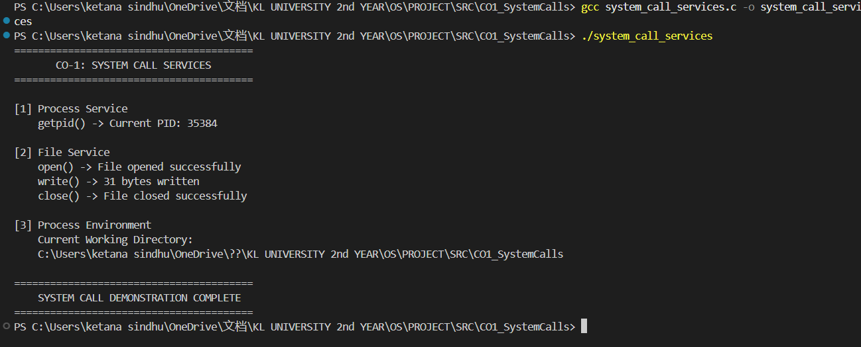
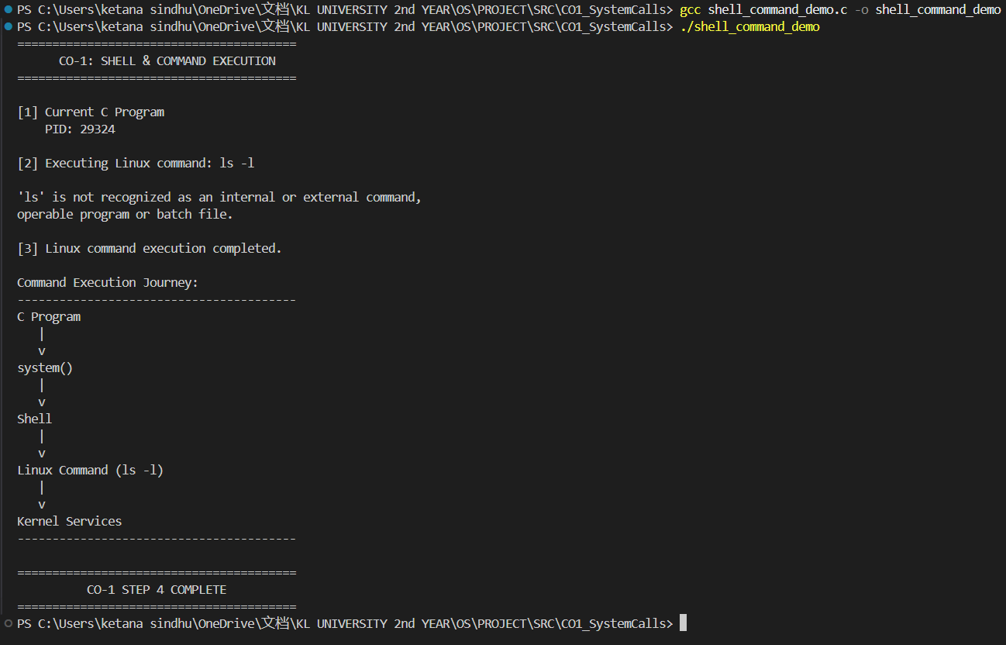
Results – CO1

Slide 6
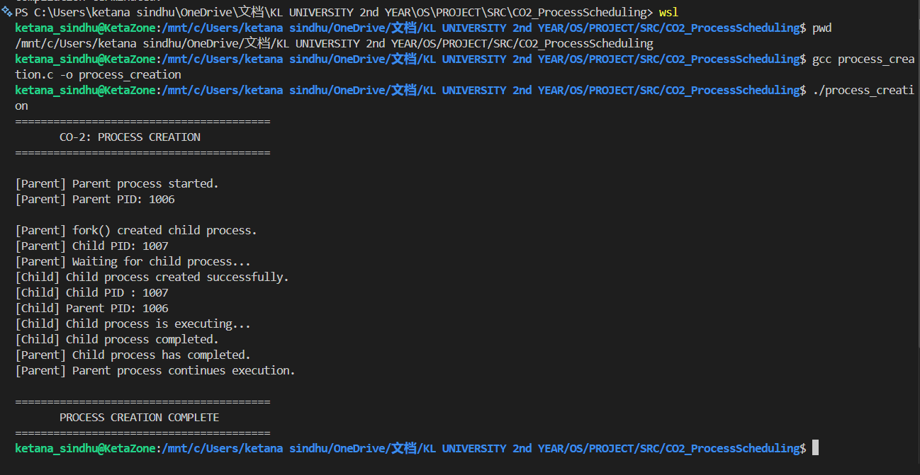
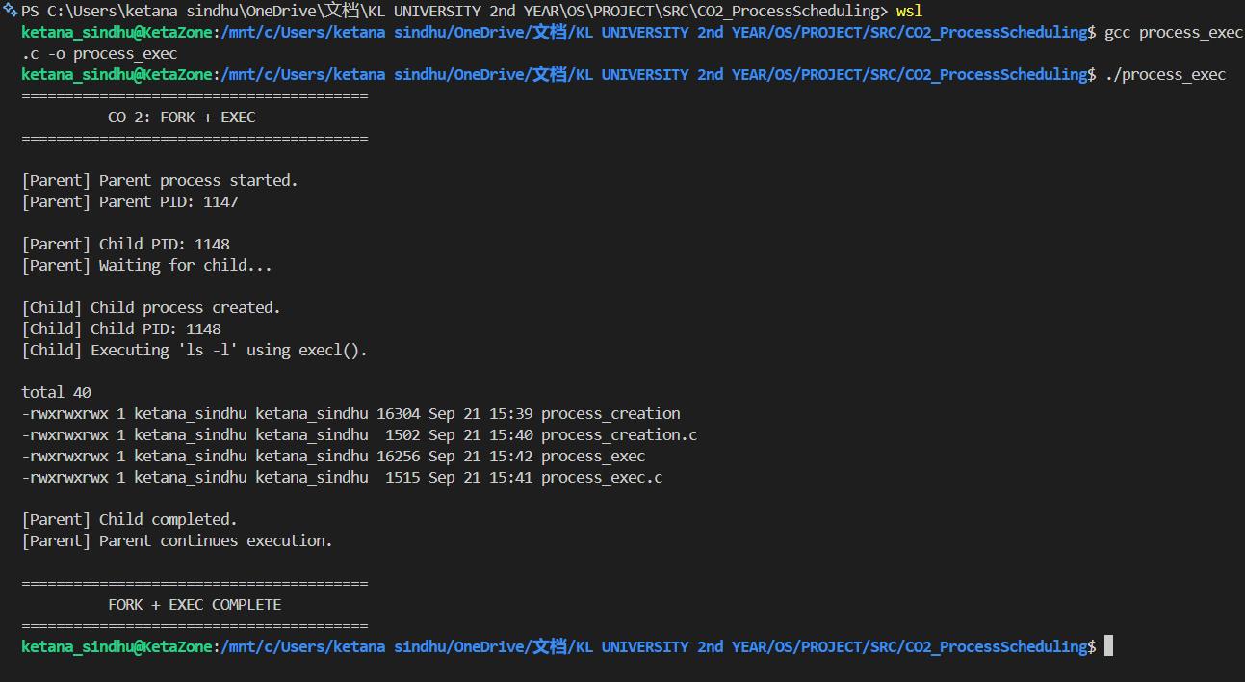
Results – CO2
PROCESS MANAGEMENT
PROCESS CREATION
Implemented process creation using fork().
Created parent and child processes.
PROCESS EXECUTION
Implemented exec() / execl().
Demonstrated program replacement.
PROCESS SYNCHRONIZATION
Used wait() for parent-child synchronization.
PROCESS LIFECYCLE
Demonstrated:
  Created
  Ready
  Running
  Terminated

Slide 7
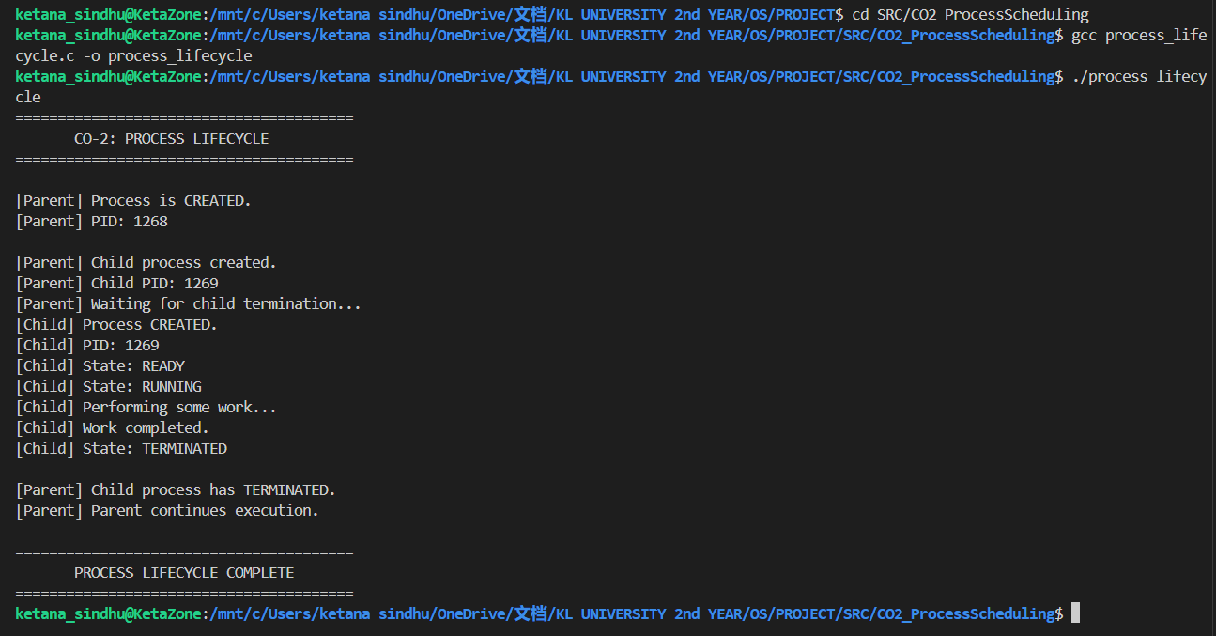
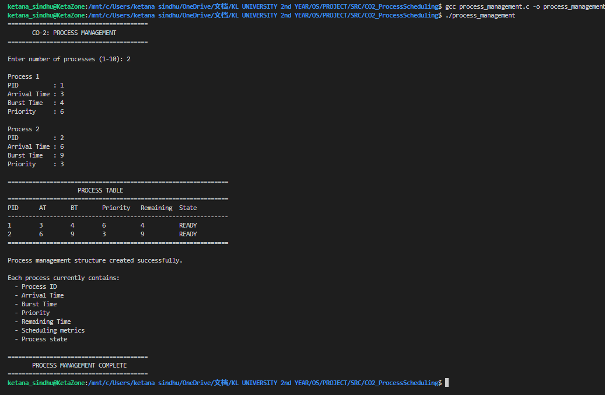
Results – CO2

Slide 8
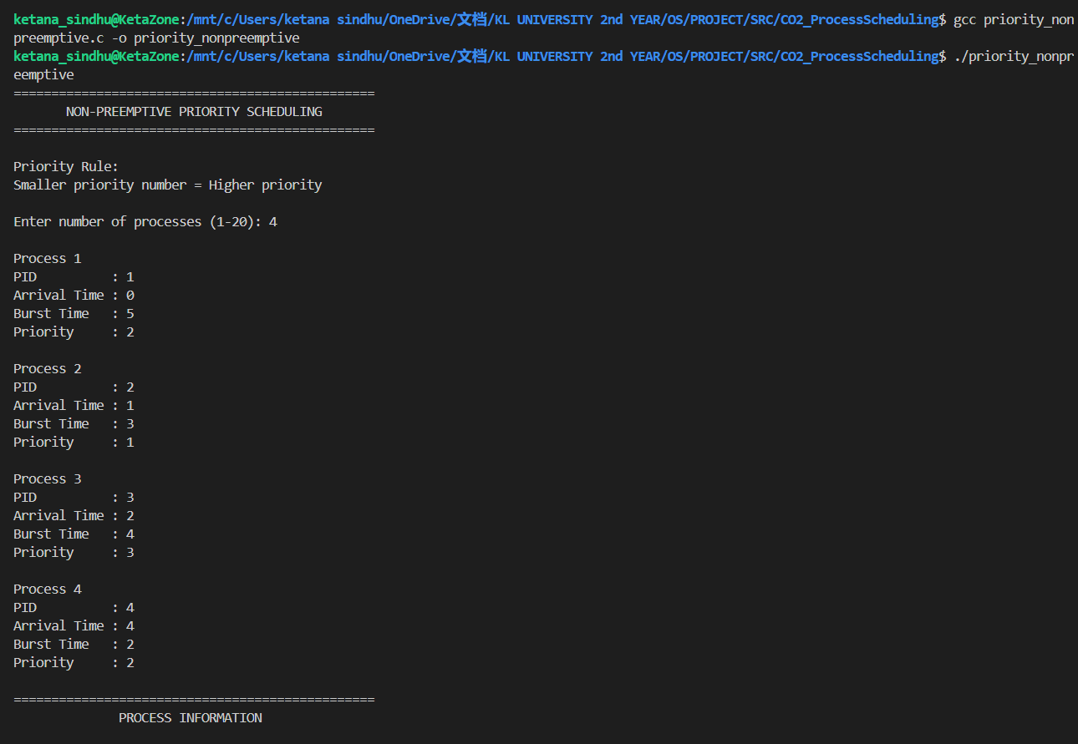
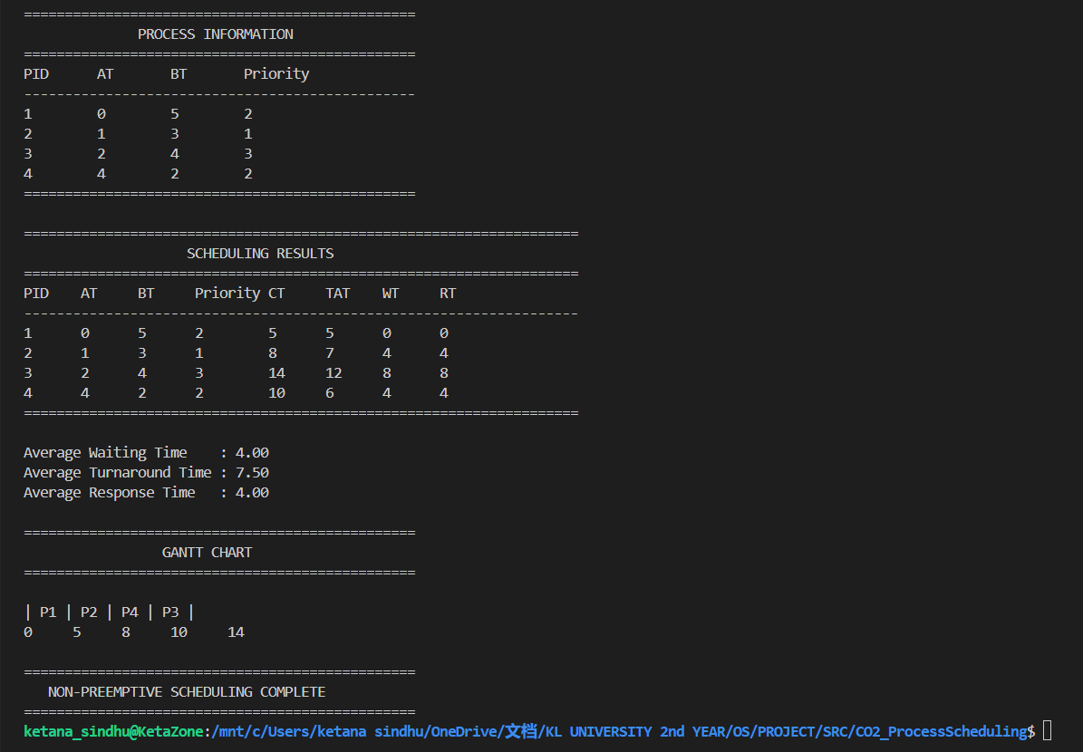
Results – CO2
NON-PREEMPTIVE PRIORITY SCHEDULING
INPUT
Process ID
Arrival Time
Burst Time
Priority
PROCESSING
Checks processes that have arrived.
Selects the highest-priority process.
Executes the selected process until completion.
Moves to the next eligible process.
OUTPUT
Completion Time
Turnaround Time
Waiting Time
Response Time
Gantt Chart

Slide 9
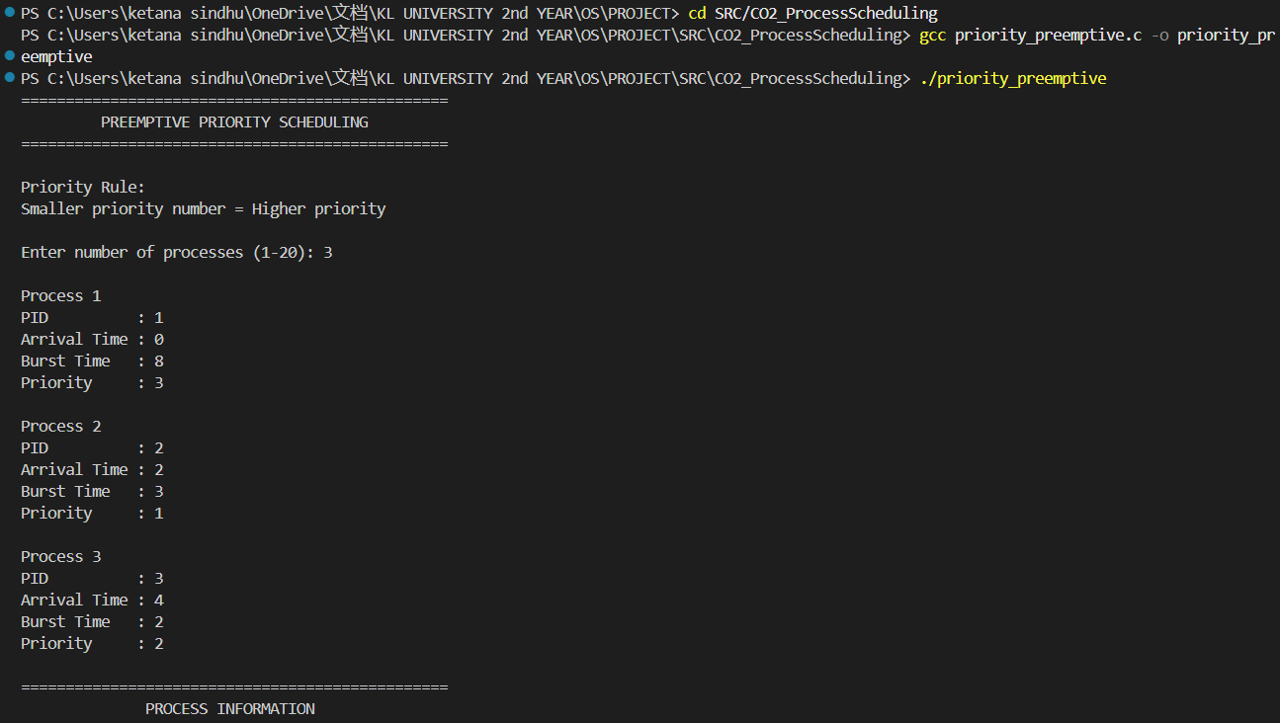
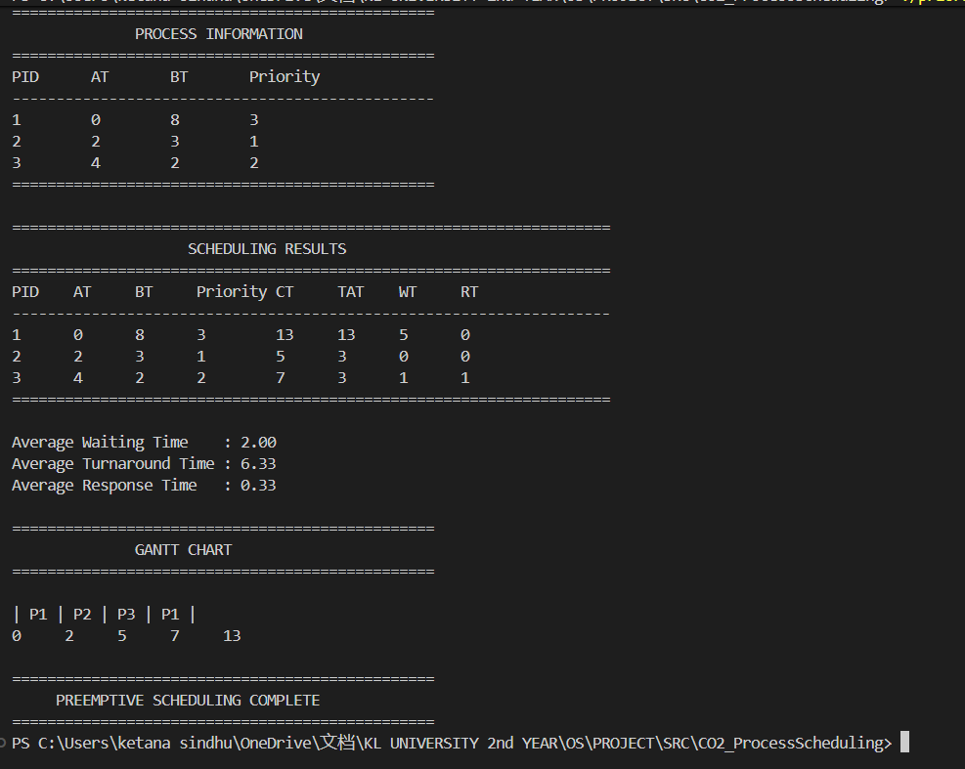
Results – CO2
PREEMPTIVE PRIORITY SCHEDULING
PROCESSING
Checks available processes at every time unit.
Selects the highest-priority process.
Allows higher-priority processes to preempt the running process.
Maintains remaining burst time.
Resumes preempted processes when selected again.
OUTPUT
Completion Time
Turnaround Time
Waiting Time
Response Time
Gantt Chart

Slide 10
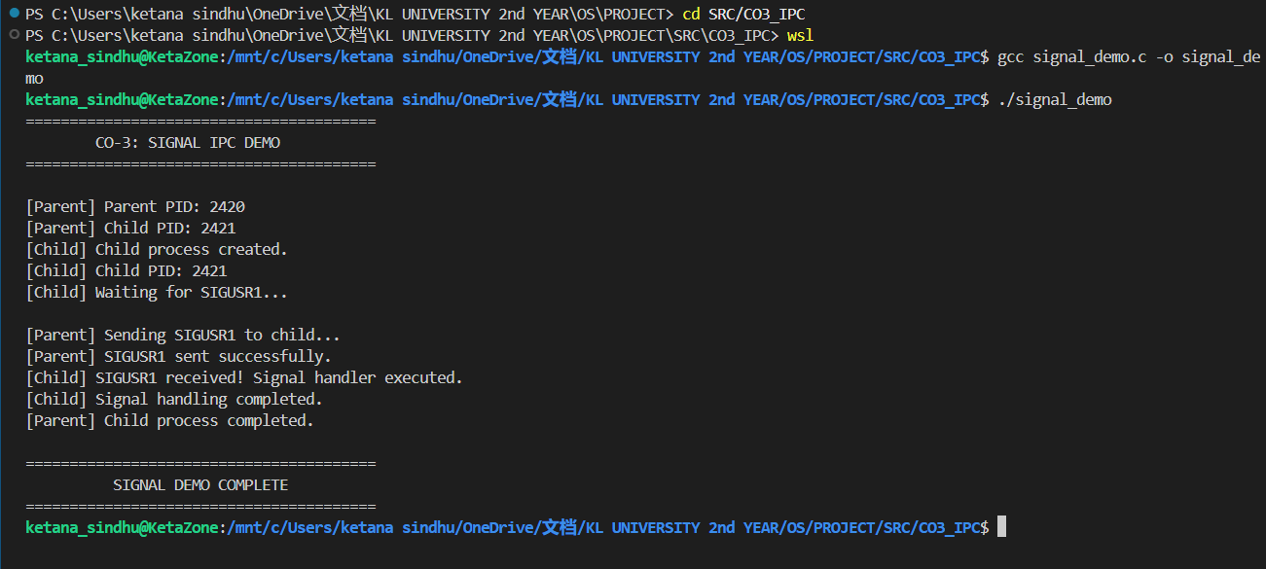
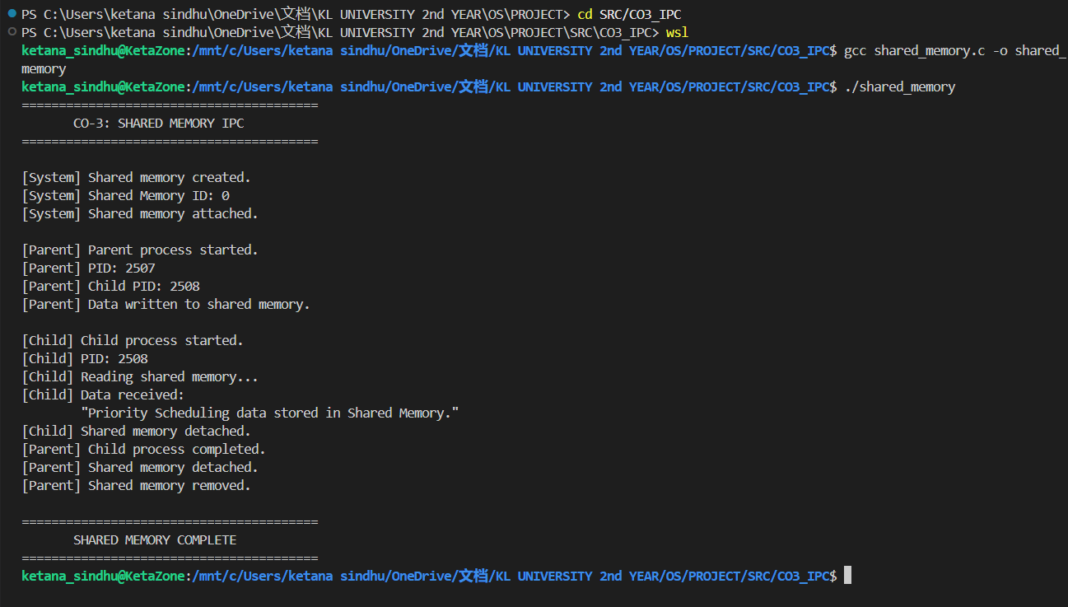
Results – CO2

Slide 11
HARDWARE & SOFTWARE
HARDWARE
Computer / Laptop
Keyboard
Display
SOFTWARE
Operating System: Linux / Ubuntu / WSL2
Programming Language: C
Compiler: GCC
Interface: Linux Terminal
Editor: Visual Studio Code
System Programming: Linux/POSIX APIs
Version Control: Git / GitHub

Slide 12
Conclusion
Developed a Linux-based Priority Scheduling project using C.
Implemented Non-Preemptive Priority Scheduling.
Implemented Preemptive Priority Scheduling.
Calculated CT, TAT, WT and RT.
Generated Gantt Charts for process execution.
Demonstrated CO-1 — Linux system calls.
Demonstrated CO-2 — Process creation and process management.
Demonstrated CO-3 — Inter-Process Communication.
Successfully tested all implemented modules.

Slide 13
Future Scope
SCHEDULING EXTENSION
Implement additional CPU scheduling algorithms.
Compare scheduling performance.
Support larger process sets.
VISUALIZATION
Develop interactive Gantt Charts.
Add graphical scheduling interface.
Provide real-time process visualization.
SYSTEM EXTENSION
Integrate additional Linux/POSIX APIs.
Extend process monitoring.
Expand IPC-based communication

Slide 14
Priority Scheduling
Thank you
Priority Scheduling — Team 20 | Section - 6
Somisetty Ketana Sindhu-2520030487
Yerrolaa Eekshitha— 2520030615
Poojitha Rani— 2520030460

